Slide 1
Help nature, change yourself!

Slide 2
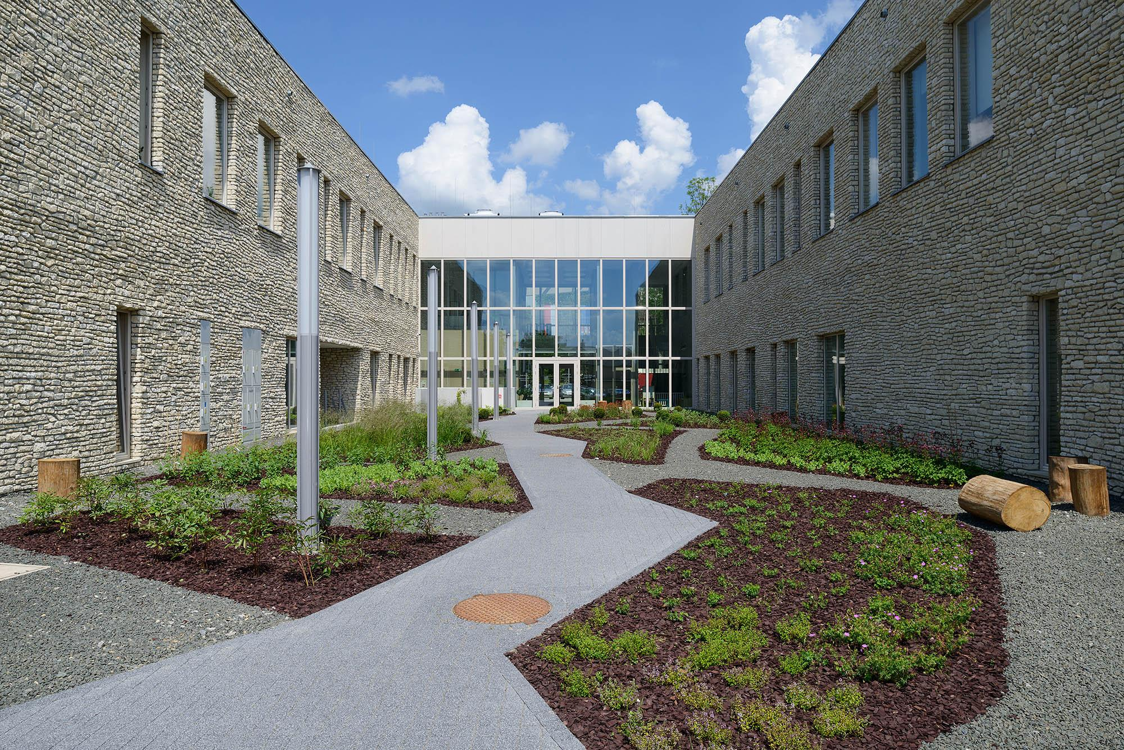
Ecological Commune Wielka Wieś
National parks:
Ojcowski National Park
Landscape parks:
Cracow Valleys
Tenczyński Landscape Park
Reserve:
Kluczwoda Valley

Slide 3
How can you help nature in our commune?
Throw your rubbish into the appropriate bins
Plant more trees and plants
Take care of clean air
Change coal stoves to gas
Don’t make fires in the forest or in a dry meadow
Don’t cut down or destroy trees

Slide 4
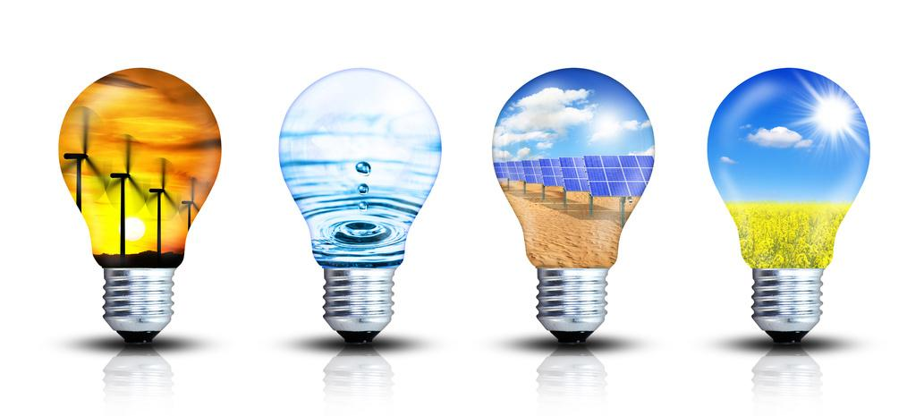
Green energy
Let’s use renewable energy sources:
sunlight
geothermal sources
wind
flowing water

Slide 5
Priceless water
We save water by:
changes in habits, washing, washing dishes
catching rainwater and seeing it in the garden

Slide 6
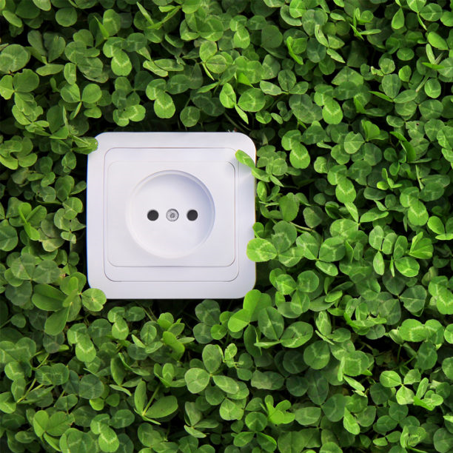
How to take care of electricity?
Turn off your electronic devices at night
Replace light bulbs and other household appliances with energy-saving ones
Use natural light

Slide 7
Thank you for your attention!

